Slide 1
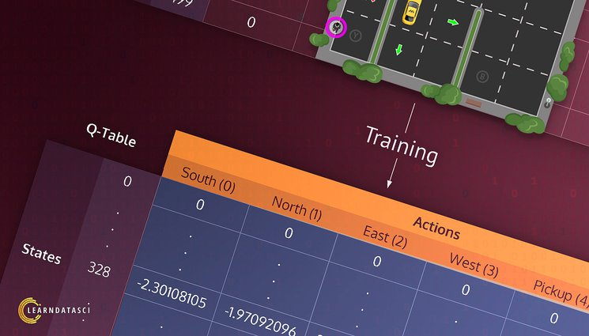
Team Members:
Shrestha Bhandari.
Adithya Sai Reddy Tamatam.

Slide 2
Project Title
Reinforcement Learning In Game.
Teach a Taxi to pick up and drop using Q Learning.

Slide 3
Deliverables Achieved
The agent's performance comparison before and after implementing Q-learning.
Training model with Pre-defined Hyperparameter
Evaluation Model for the agent
Drop off the passenger to the right location.

Slide 4
Additional Deliverables Achieved
Implement a grid search to discover the best hyperparameters
Evaluation Model for the agent with best hyperparameters.

Slide 5
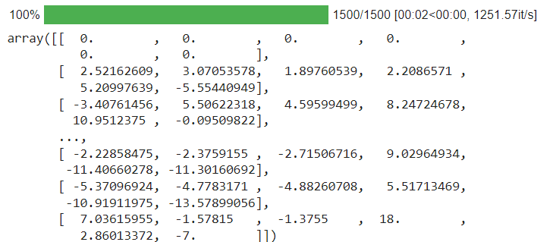
ADD Screenshots Here
Evaluation Function result before Q-Learning
Evaluation function after q-learning
Evaluation function result best hyperparameter agent

Slide 6
Thank You

